Slide 1

Credit Card Scam Detection
Group 2
Poorvi Rajendra Raut
Anushree Rawat
Amna Shamshad
Priyanka De

Slide 2
Project Overview
INTRODUCTION
DATA SET ANALYSIS
PREPROCESSING DATA
EDA (EXPLORATORY DATA ANALYSIS)
FEATURE ENCODING AND CORRELATION
BALANCING DATA
MACHINE LEARNING MODELS
CONCLUSION
FUTURE WORK

Slide 3
INTRODUCTION
Credit card scam is a type of financial crime that involves the unauthorized use of a credit or debit card to make purchases or withdraw funds. It is a significant problem for banks, credit card companies, merchants, and consumers, with billions of dollars lost annually to fraudsters.
One of the most effective ways to detect credit card scam is through the use of machine learning algorithms.
The ultimate goal is to create a system for detecting credit card scam that can precisely identify fraudulent transactions.

Slide 4
DATA SET ANALYSIS
Source of Dataset: https://www.kaggle.com/datasets/kartik2112/fraud-detection?resource=download
Our dataset provides all information containing all transaction details to determine a transaction is fraud or not fraud
Here our dataset already been divided into training and testing sets, but we have merged it together and now entire dataset contains 1,852,394 rows and 22 columns.
Our goal is to determine our target variable : is_fraud as fraud transaction (1) or not fraud transaction (0)

Slide 5
DATA SET OVERVIEW
Variable | Description
trans_date_trans_time | Transaction timestamp
cc_num | Unique credit card number
merchant | Merchant name
category | Transaction category
amt | Transaction amount
merch_long | Longitude of merchant
merch_lat | Latitude of merchant
is_fraud | Nature of transaction
trans_num | Transaction number
unix_time | Time in unix format
Variable | Description
first | First name of cardholder
last | First name of cardholder
gender | Sex of cardholder
street | Transaction address
city | Transaction city
state | Transaction state
zip | Transaction zip code
job | Job of the cardholder
dob | Date of birth of cardholder
city_pop | Population of the city

Slide 6
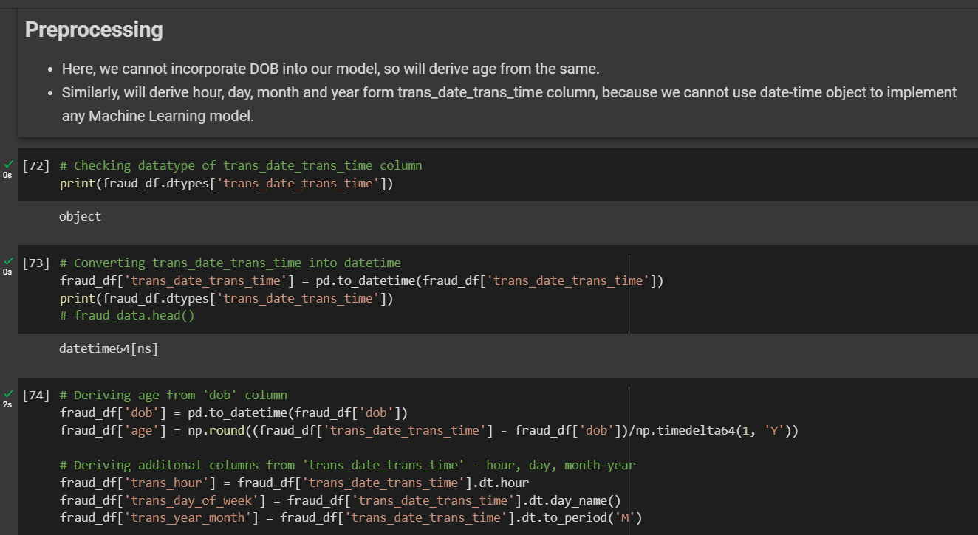
PRE-PROCESSING DATA
In dataset we have DOB column
which is of object type that cannot be
incorporated directly into our model,
so will derive age from the same.
Similarly, we have derived hour, day
and month-year from trans_date_trans_time column, because we cannot use date-time object to
implement any Machine Learning model.
After checking missing values, scaling has been done on the entire dataset too.

Slide 7
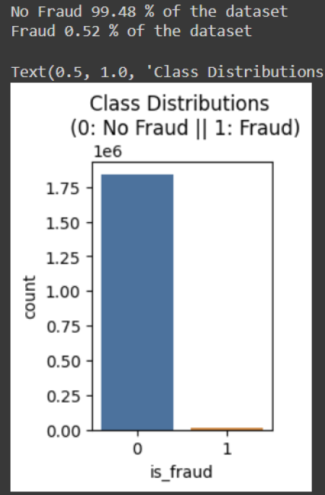
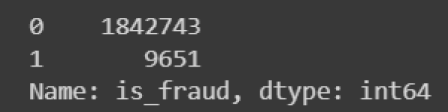
EDA (Exploratory Data Analysis)
Starting EDA from target variable, which is is_fraud column according to our dataset
Here, we can see that dataset is highly skewed, which needs to be fixed. Otherwise while implementing ML models it will have biases for high volume data

Slide 8
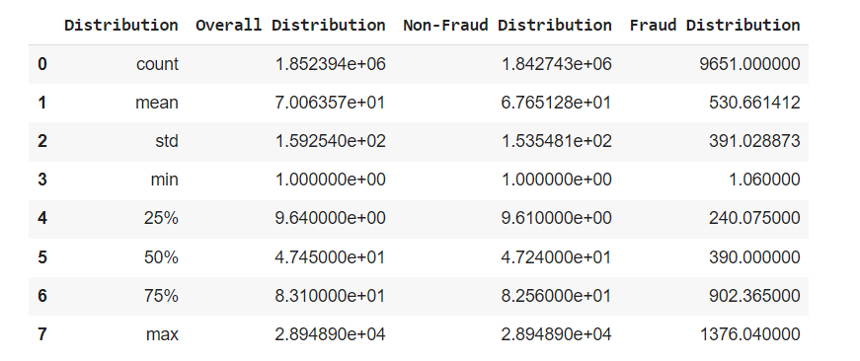
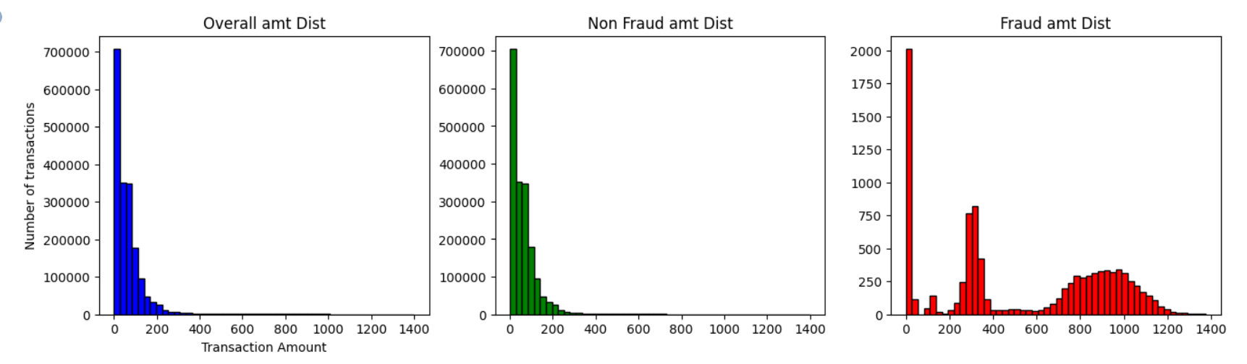
EDA
Data Summarization:
Here, the mean/average of the 'fraud distribution' is way higher than the 'non-fraud distribution'.
That means the amount lost in a fraud transaction is very high. Which is a usual behaviour looking at the real-life scenarios.
Data Visualization:
The histogram plot of the fraud and non-fraud distribution shows that the Transaction amount is very high, for fraud distributions

Slide 9
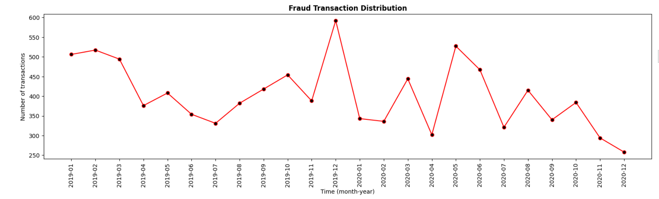
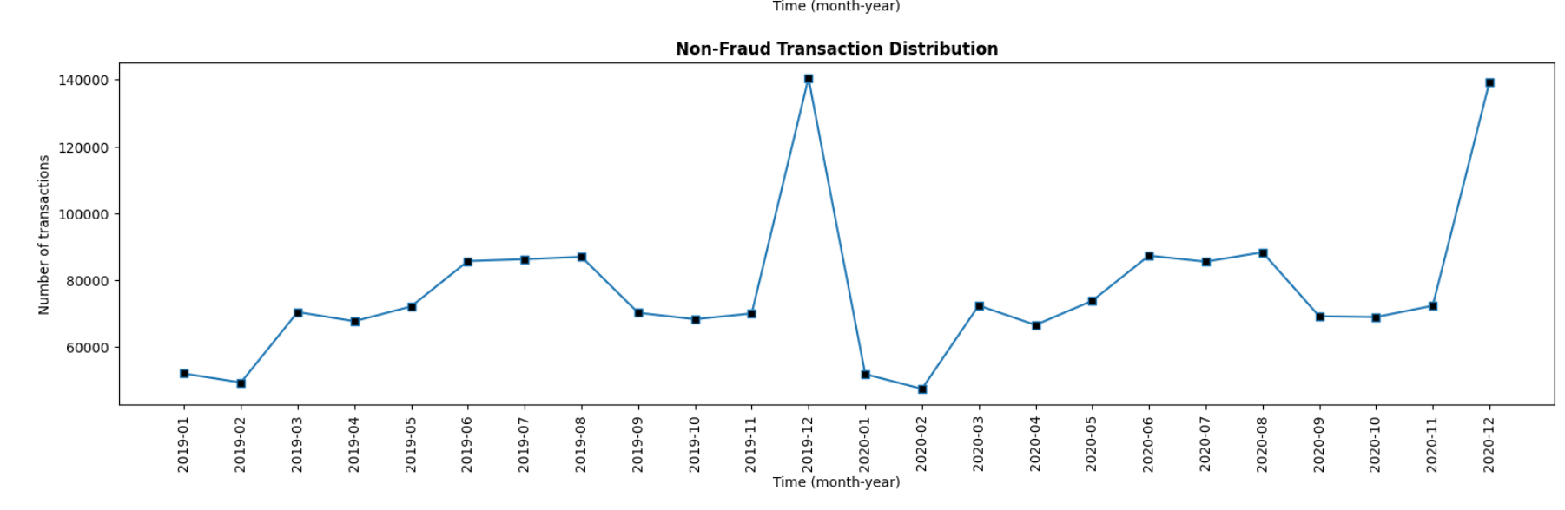
EDA
Correlation Analysis:
Correlation between time(year_month) vs number of transactions examined. Red for fraud and blue for non-fraud.
Shows high fraud transactions in 2019-12 and reduced fraud transactions in 2020-12

Slide 10
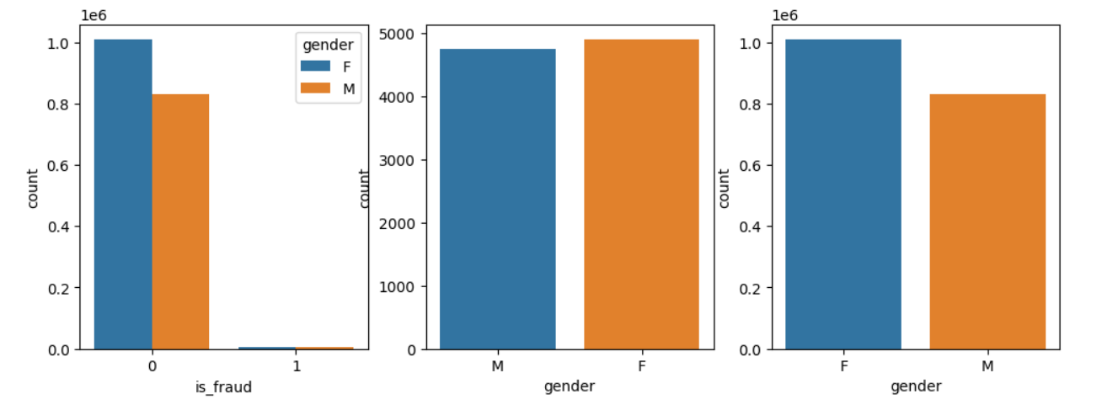
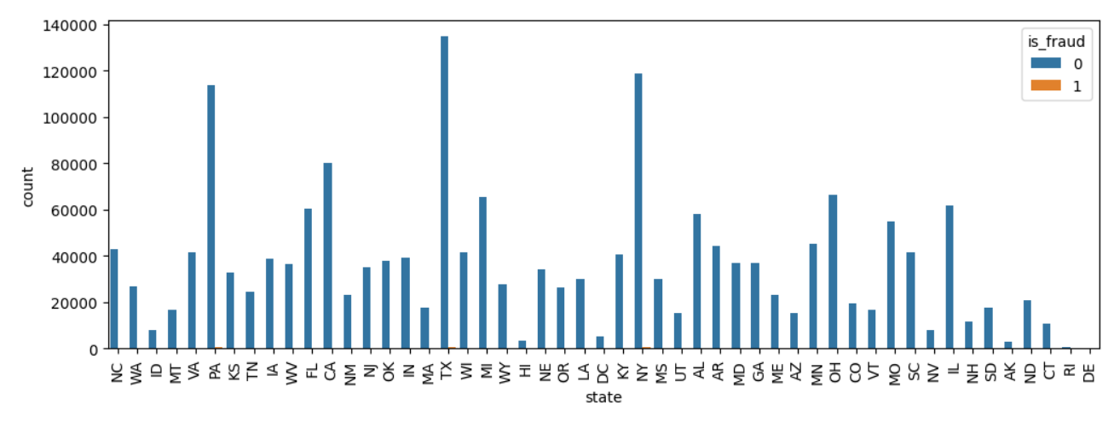
EDA
Correlation Analysis:
Gender vs target variable.
Shows high fraud transactions for Female, compared to males.
Correlation Analysis:
State vs target variable.
Looking at the graph most number of transactions are noted in 3 states (PA, TX and NY).
*similarly we have explored all the features.

Slide 11
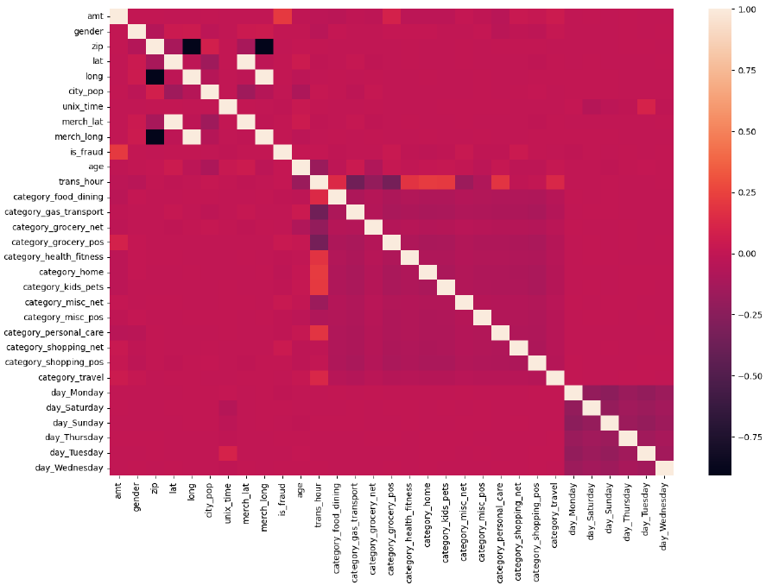
Feature Encoding and Correlation
One hot encoding
One hot encoding is a technique that we use to represent categorical variables as numerical values in a machine learning model.
Direct mapping
In this method, each unique value or category in a feature is assigned a unique numerical code, also known as an encoding.
Here, we have dropped some of the unnecessary and encoded columns.

Slide 12
Balancing Data
We have implemented Logistic Regression model without balancing the skewness in the data and we got following result:
We got least precision and recall, which shows less precision and completeness to predict true positive of the model

Slide 13
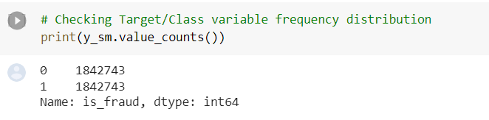
Balancing Data
We have tried three different sampling method:
Random Under Sampling
Random Over Sampling
SMOTE method
And finalized SMOTE (Synthetic Minority Oversampling Technique) method to balance our dataset

Slide 14
Machine
Learning
Models

Slide 15
Logistic Regression without balancing
In Logistic Regression, we model the probability of an event occurring given a set of independent input variables.
When training a logistic regression model without balancing the classes, it means that we are not adjusting the training data to address any class imbalance that may exist. This can lead to biased results, where the model may over-predict the majority class and under-predict the minority class.
With an unbalanced dataset which has bias, we get an accuracy of 99.4%

Slide 16
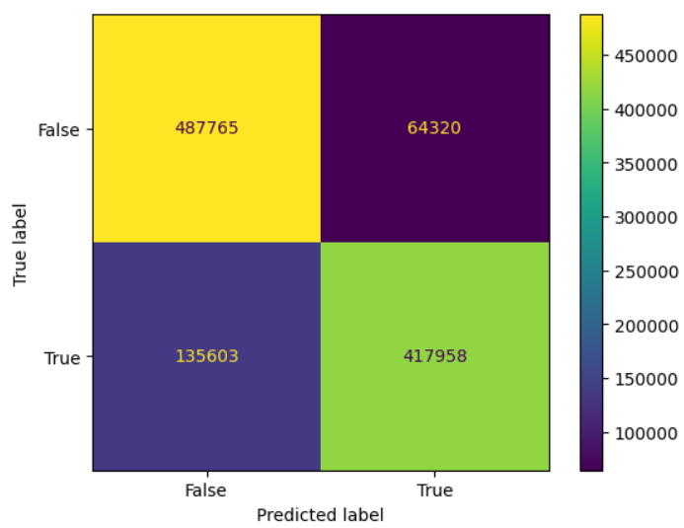
Logistic Regression with balancing using SMOTE
When training a logistic regression model, it is important to address any class imbalance that may exist to prevent biased results. SMOTE or Synthetic Minority Oversampling Technique is an oversampling technique.
In oversampling technique, the minority data is duplicated from the minority data. While it increases the number of data, it does not give any new information or variation to the machine learning model.
With sampling strategy as “minority”, we get 81.9% accuracy

Slide 17
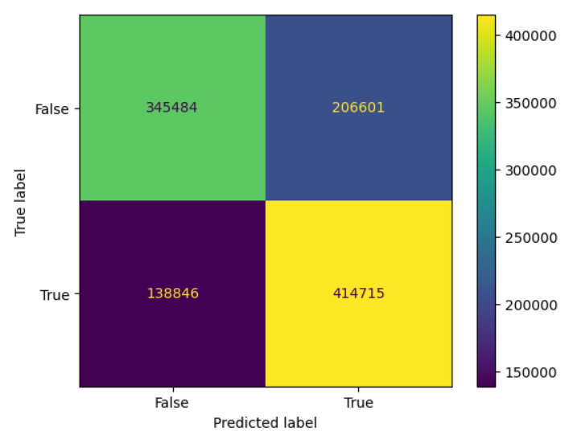
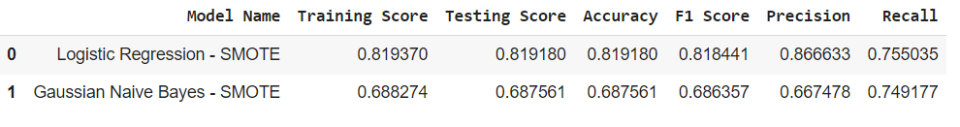
Gaussian Naive Bayes
Naive Bayes is a supervised machine learning algorithm based on Bayes' theorem with “naive” assumption that the features are independent of each other given the class label.
The Naive Bayes algorithm assumes that the features are continuous and follow a Gaussian (normal) distribution. . In other words, it computes the probability of each class given the features using the distribution.
we get an accuracy of 68.7%

Slide 18
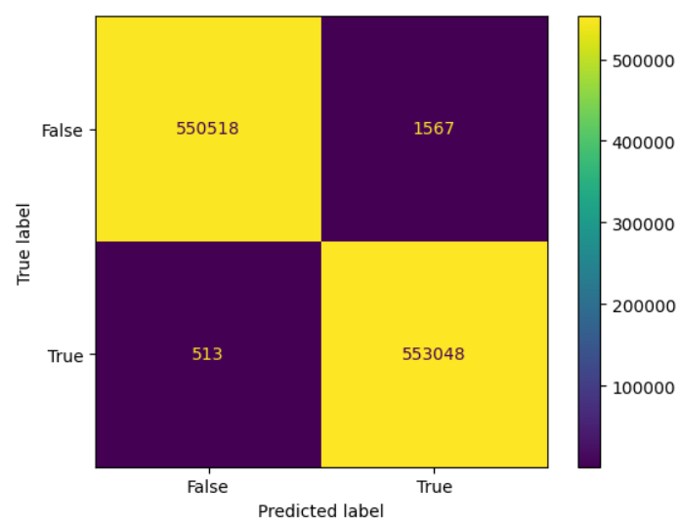
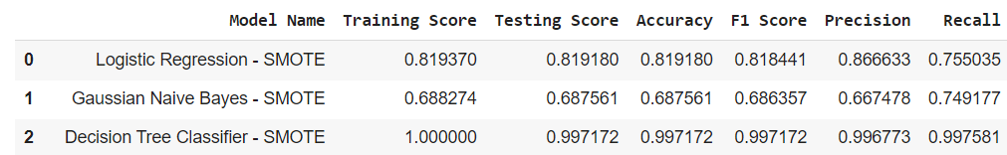
DECISION TREE: CART (CLASSIFICATION AND REGRESSION TREE)
CART is a decision tree algorithm that can be used for both classification and regression tasks. The algorithm works by recursively splitting the data into subsets based on the value of a chosen feature, with the goal of maximizing the purity of the resulting subsets.
In CART, each internal node of the tree represents a feature, and each branch represents a possible value of that feature. The leaves of the tree represent the final decision or prediction.
We get an accuracy of 99.7%

Slide 19
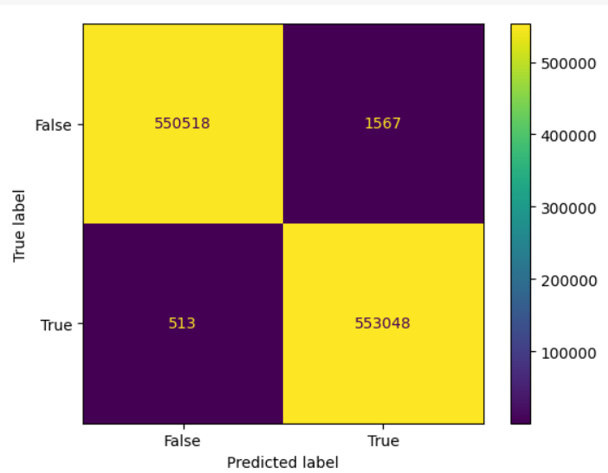
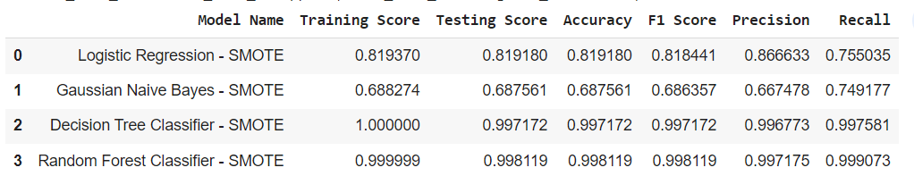
RANDOM FOREST
Random forest consists of a large number of individual decision trees that operate as an ensemble.
Each individual tree in the random forest spits out a class prediction and the class with the most votes becomes the model’s prediction
With n_estimators as 100 and minimum leaf size as 1, we get 99.8% accuracy.

Slide 20
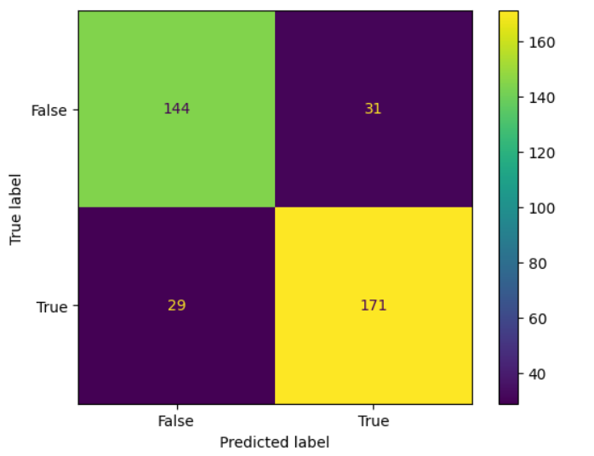
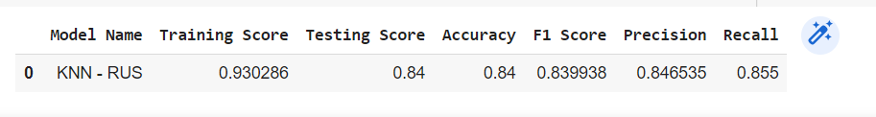
K-NEAREST NEIGHBOR (KNN)
The k-nearest neighbors (KNN) algorithm is a simple, easy-to-implement supervised machine learning algorithm that can be used to solve both classification and regression problems
The KNN algorithm assumes that similar things exist in close proximity. In other words, similar things are near to each other.
With number of neighbours as 3 and uniform weights, we get an accuracy of 84.6%

Slide 21
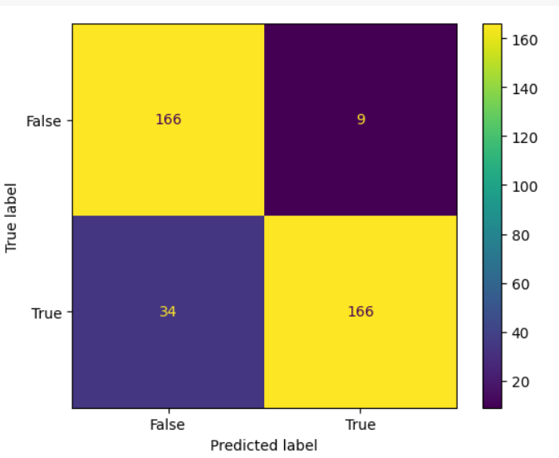
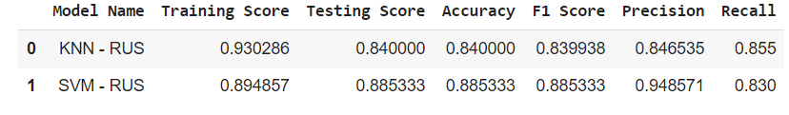
SUPPORT VECTOR MACHINE
SVM works by mapping data to a high-dimensional feature space so that data points can be categorized, even when the data are not otherwise linearly separable.
A separator between the categories is found, then the data are transformed in such a way that the separator can be drawn as a hyperplane.
With trade off value as 1 and degree of polynomial 3, we get 88.6% accuracy

Slide 22
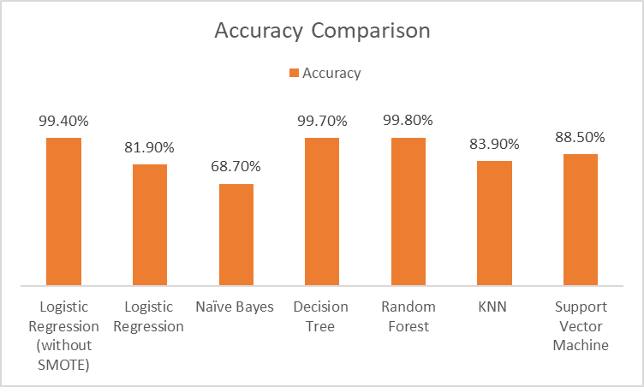
CONCLUSION
Here, every model is being evaluated using
many factors such as accuracy, precision,
recall, F1 score etc.
Looking at the figures it can be seen
that top most efficient models for
our data and distribution are:
Decision Tree
Random Forest

Slide 23
FUTURE WORK
Looking at the data veracity and its volume, which model/ml algorithm is to select is a very crucial decision. Moreover, cleaning and processing data according to the algorithm is more important and effort taking task then implementing a Machine Learning Model.
Working on this project, we gain knowledge and some chief insights of the definition: credit card scam detection.
This project can be incorporated into online business like e-commerce, online banking where chances of fraudulent transaction is very high. And in the further extension we can try to fit more complex data within our model and to predict it accurately.

Slide 24
THANK
YOU

